Slide 1
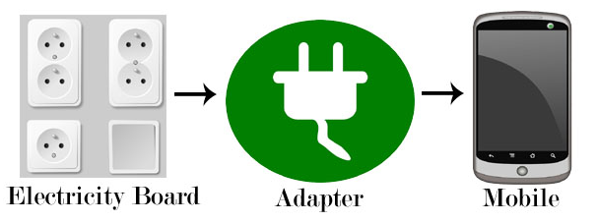
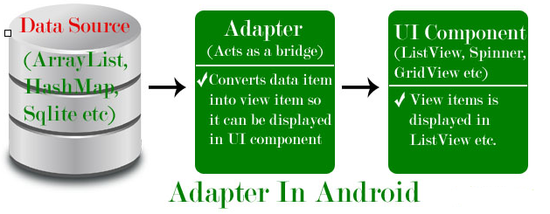
Adapter
Adapter is a bridge between UI component and data source that helps us to fill data in UI component.
It holds the data and send the data to an Adapter view then view can takes the data from the adapter view and shows the data on different views like as ListView, GridView, Spinner etc.
To fill data in a list or a grid we need to implement Adapter.
Here data source is the source from where we get the data and UI components are list or grid items in which we want to display that data.

Slide 2
Adapter
Adapters In Android:
There are the some commonly used Adapter in Android used to fill the data in the UI components:
BaseAdapter – It is parent adapter for all other adapters
ArrayAdapter – It is used whenever we have a list of single items which is backed by an array
Custom ArrayAdapter – It is used whenever we need to display a custom list
SimpleAdapter – It is an easy adapter to map static data to views defined in your XML file
Custom SimpleAdapter – It is used whenever we need to display a customized list and needed to access the child items of the list or grid
Note :
ArrayAdapter is more simple and commonly used Adapter in android.
Whenever you have a list of single type of items like an array, we use ArrayAdapter. Ex. List of phone contacts, countries or names.

Slide 3
ListView
List of scrollable items can be displayed in Android using ListView.
Users can then select any list item by clicking on it.
ListView is default scrollable
A very common example of ListView is your phone contact book, where you have a list of your contacts displayed in a ListView and if you click on it then user information is displayed.

Slide 4
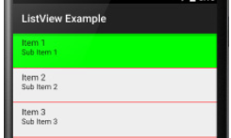
ListView
Attributes of ListView:
id: id is used to uniquely identify a ListView.
divider: This is a drawable or color to draw between different list items.
dividerHeight: This specify the height of the divider between list items.
listSelector: listSelector property is used to set the selector of the listView. It is generally orange or Sky blue color mostly but you can also define your custom color or an image as a list selector as per your design.
<ListView
android:id="@+id/simpleListView"
android:layout_width=“match_parent"
android:layout_height="wrap_content"
android:divider="#f00"
android:dividerHeight="1dp"
android:listSelector="#0f0"/> <!--list selector in green color-->

Slide 5
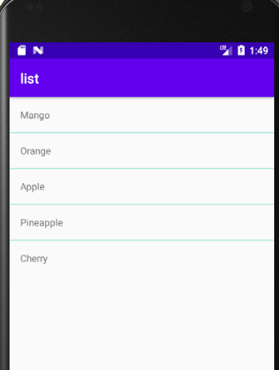

Slide 6
ListView
<LinearLayout xmlns:android="http://schemas.android.com/apk/res/android"
android:layout_width="match_parent"
android:layout_height="match_parent"
android:orientation="vertical">
<ListView
android:id="@+id/simpleListView"
android:layout_width="wrap_content"
android:layout_height="wrap_content"
android:divider="@color/material_blue_grey_800"
android:dividerHeight="1dp" />
</LinearLayout>

Slide 7
ListView
activity_listview.xml
<?xml version="1.0" encoding="utf-8"?>
<LinearLayout xmlns:android="http://schemas.android.com/apk/res/android"
android:layout_width="match_parent"
android:layout_height="match_parent"
android:orientation="vertical">
<TextView
android:id="@+id/textView"
android:layout_width="match_parent"
android:layout_height="wrap_content"
android:layout_gravity="center"
android:padding="16dp"
android:textColor="@color/black" />
</LinearLayout>

Slide 8
ListView
mainActivity.java
public class MainActivity extends AppCompatActivity {
// Array of strings...
ListView simpleList;
String countryList[] = {"India", "China", "australia", "Portugle", "America", "NewZealand"};
@Override protected void onCreate(Bundle savedInstanceState) {
super.onCreate(savedInstanceState);
setContentView(R.layout.activity_main);
simpleList = findViewById(R.id.simpleListView);
ArrayAdapter<String> arrayAdapter = new ArrayAdapter<String>(this, R.layout.activity_listview, R.id.textView, countryList);
simpleList.setAdapter(arrayAdapter);
}

Slide 9
ListView
mainActivity.java
simpleList.setOnItemClickListener(new AdapterView.OnItemClickListener() {
@Override
public void onItemClick(AdapterView<?> parent, View view, int position, long id) {
String value = arrayAdapter.getItem(position);
Toast.makeText(getApplicationContext(),value,Toast.LENGTH_SHORT).show();
}
});
}
}

Slide 10
ListView – Base Adapter
BaseAdapter is a common base class of a general implementation of an Adapter that can be used in ListView.
Whenever you need a customized list you create your own adapter and extend base adapter in that.
Base Adapter can be extended to create a custom Adapter for displaying a custom list item.
ArrayAdapter is also an implementation of BaseAdapter.

Slide 11
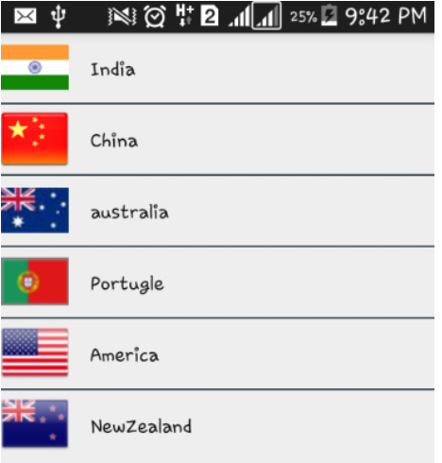
ListView – Base Adapter

Slide 12
<?xml version="1.0" encoding="utf-8"?>
<LinearLayout xmlns:android="http://schemas.android.com/apk/res/android"
android:layout_width="match_parent"
android:layout_height="match_parent"
android:orientation="vertical">
<ListView
android:id="@+id/simpleListView"
android:layout_width="fill_parent"
android:layout_height="wrap_content"
android:divider="@color/colorPrimaryDark"
android:dividerHeight="1dp"
/>
</LinearLayout>

Slide 13
activity_listview.xml
<?xml version="1.0" encoding="utf-8"?>
<LinearLayout xmlns:android="http://schemas.android.com/apk/res/android"
android:layout_width="match_parent"
android:layout_height="match_parent"
android:orientation="horizontal">
<ImageView
android:id="@+id/icon"
android:layout_width="50dp"
android:layout_height="50dp"
/>
<TextView
android:id="@+id/textView"
android:layout_width="fill_parent"
android:layout_height="wrap_content"
android:layout_gravity="center"
android:padding=“15dp"
android:textColor="@color/black" />
</LinearLayout>

Slide 14
import android.app.Activity;
import android.os.Bundle;
import android.widget.ListView;
public class MainActivity extends Activity {
ListView simpleList;
String countryList[] = {"India", "China", "australia", "Portugle", "America", "NewZealand"};
int flags[] = {R.drawable.india, R.drawable.china, R.drawable.australia, R.drawable.portugle, R.drawable.america, R.drawable.new_zealand};
@Override
protected void onCreate(Bundle savedInstanceState) {
super.onCreate(savedInstanceState);
setContentView(R.layout.activity_main);
simpleList = (ListView) findViewById(R.id.simpleListView);
CustomAdapter customAdapter = new CustomAdapter(getApplicationContext(), countryList, flags);
simpleList.setAdapter(customAdapter);
}
}

Slide 15
CustomAdapter.java
public class CustomAdapter extends BaseAdapter {
Context context;
String countryList[];
int flags[];
LayoutInflater inflter;
public CustomAdapter(Context applicationContext, String[] countryList, int[] flags) {
this.context = context;
this.countryList = countryList;
this.flags = flags;
inflter = (LayoutInflater.from(applicationContext));
}
@Override
public int getCount() {
return countryList.length;
}
@Override
public Object getItem(int i) {
return null;
}
@Override
public long getItemId(int i) {
return 0;
}

Slide 16
@Override
public View getView(int i, View view, ViewGroup viewGroup) {
view = inflter.inflate(R.layout.activity_listview, null);
TextView country = (TextView) view.findViewById(R.id.textView);
ImageView icon = (ImageView) view.findViewById(R.id.icon);
country.setText(countryList[i]);
icon.setImageResource(flags[i]);
return view;
}

Slide 17
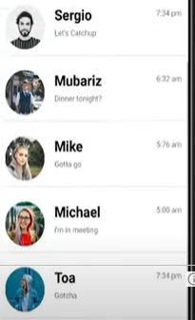
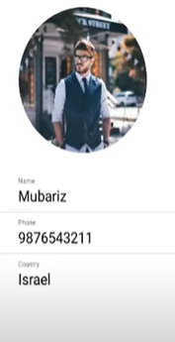

Slide 18
